Slide 1
Goals this Week
1. Work on your CMS assignment

Slide 2
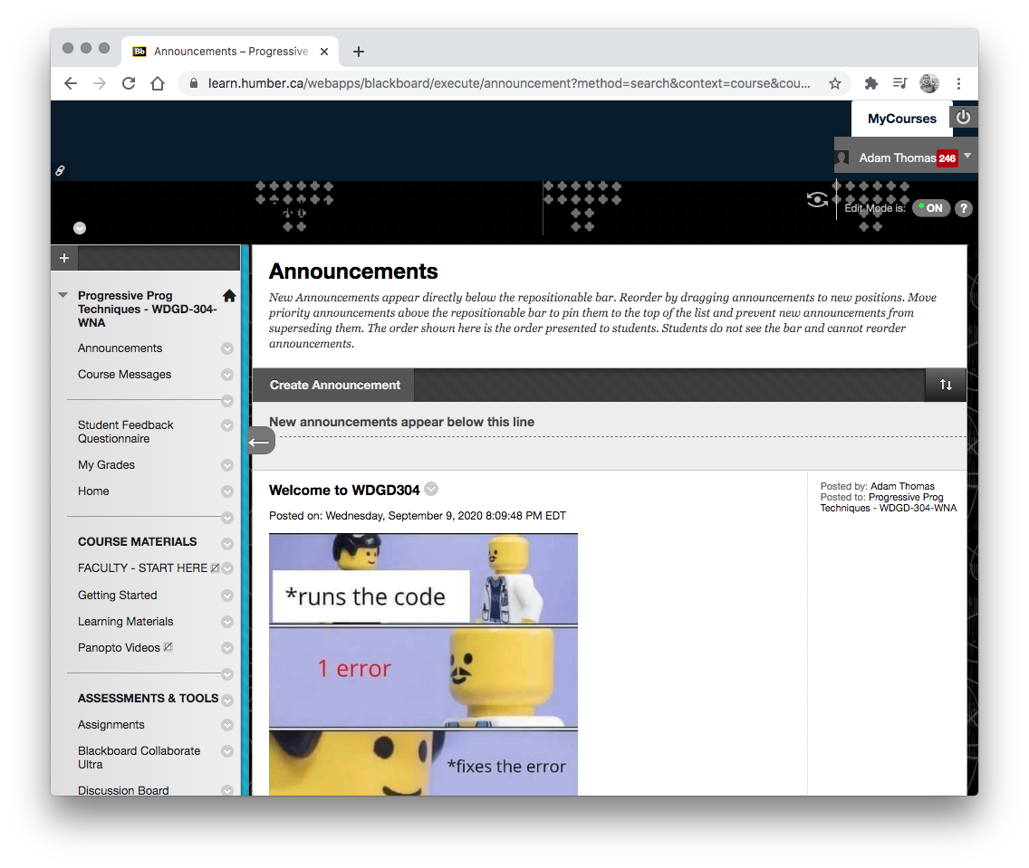
1. Assignments
Your PHP CMS assignment is due on March 17th
Work on creating the PHP CMS backend as a group. Then work on your own frontend.

Slide 3
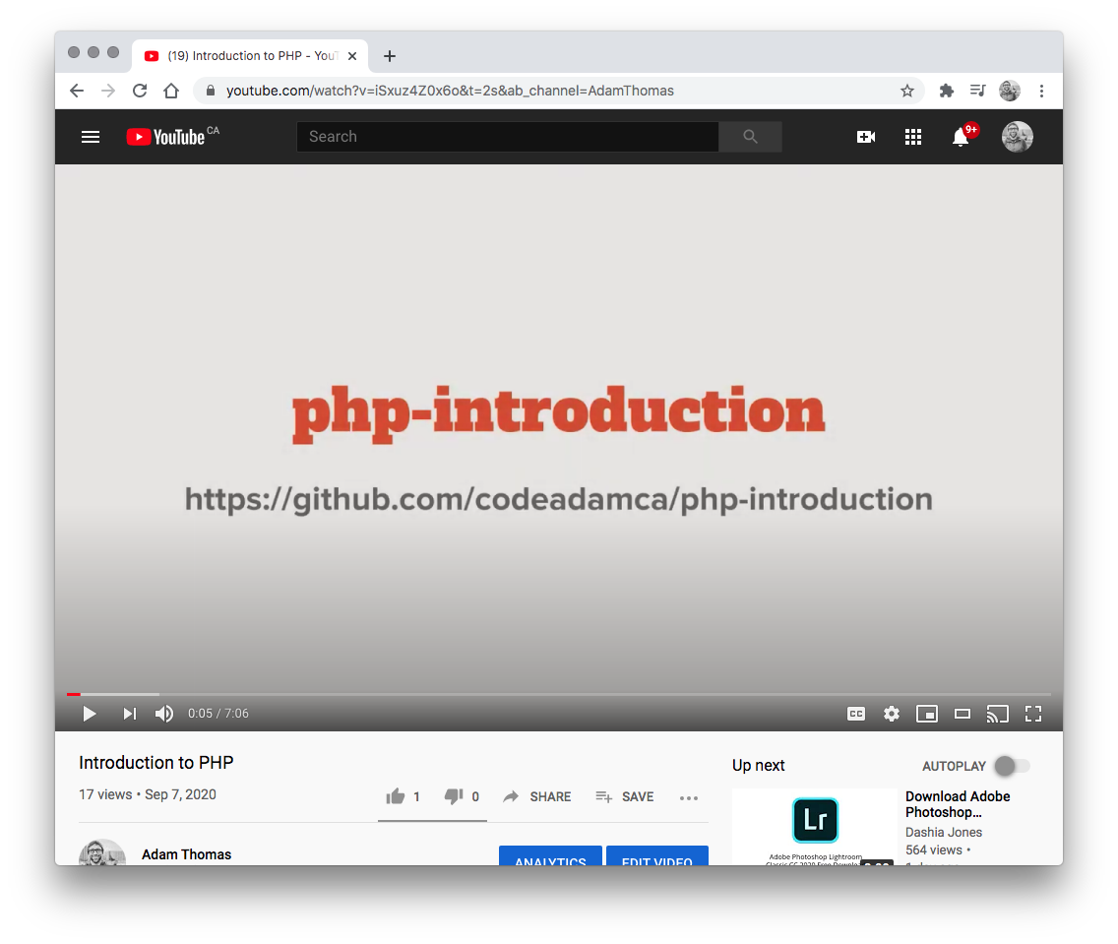

2. Videos
Create a Custom CMS with Laravel
Creating a PHP and Laravel CMS - Step 1 - Installing Laravel https://www.youtube.com/watch?v=WBhEhZCPPoY

Slide 4
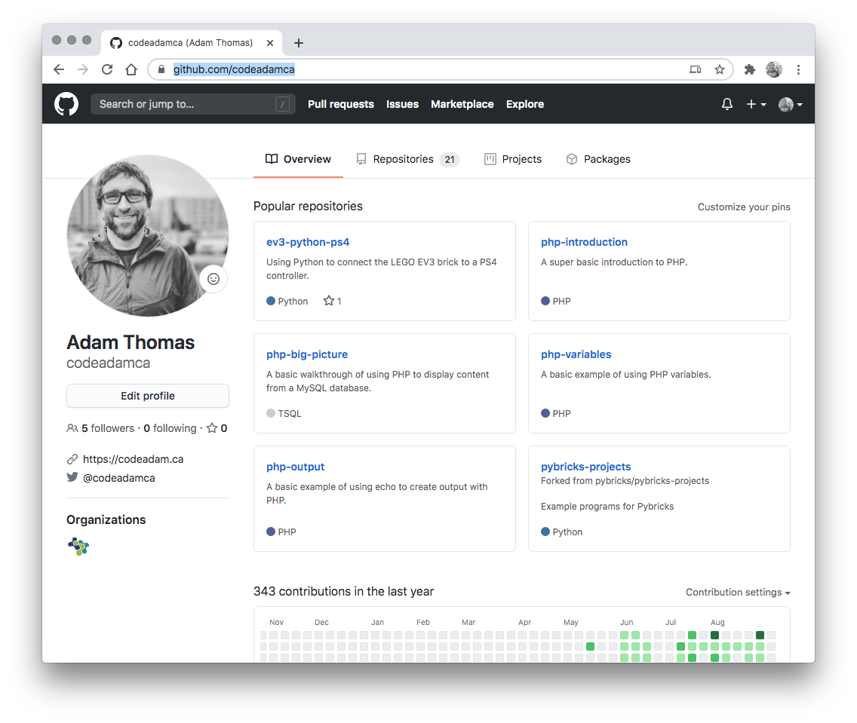

3. Review Code
Review the provided code and follow along with any coding instructions in GitHub:
Laravel and PHP CMS: https://github.com/codeadamca/laravel-php-cms
Laravel and Blade CMS: https://github.com/codeadamca/laravel-blade-cms

